Slide 1

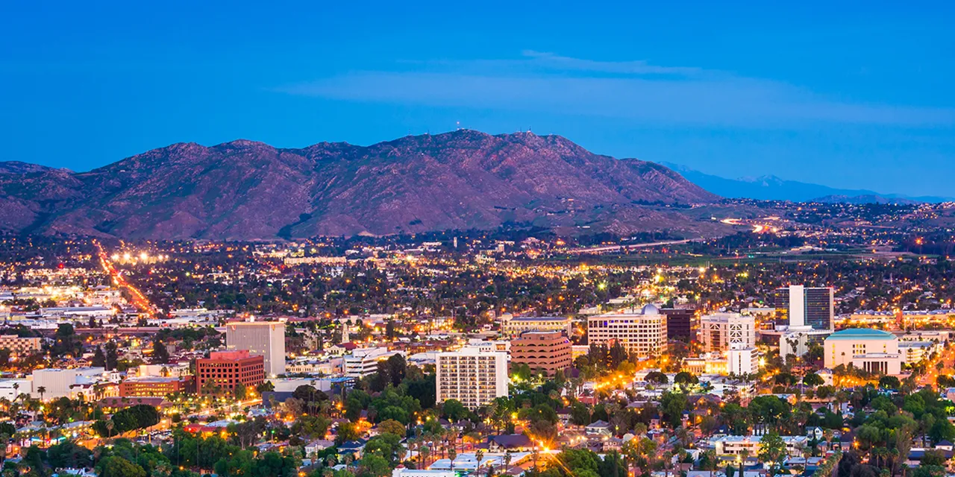
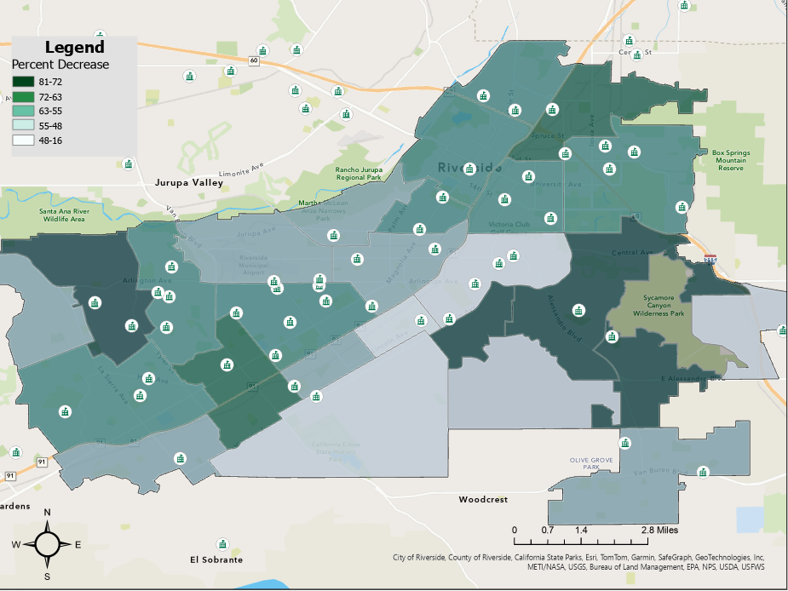
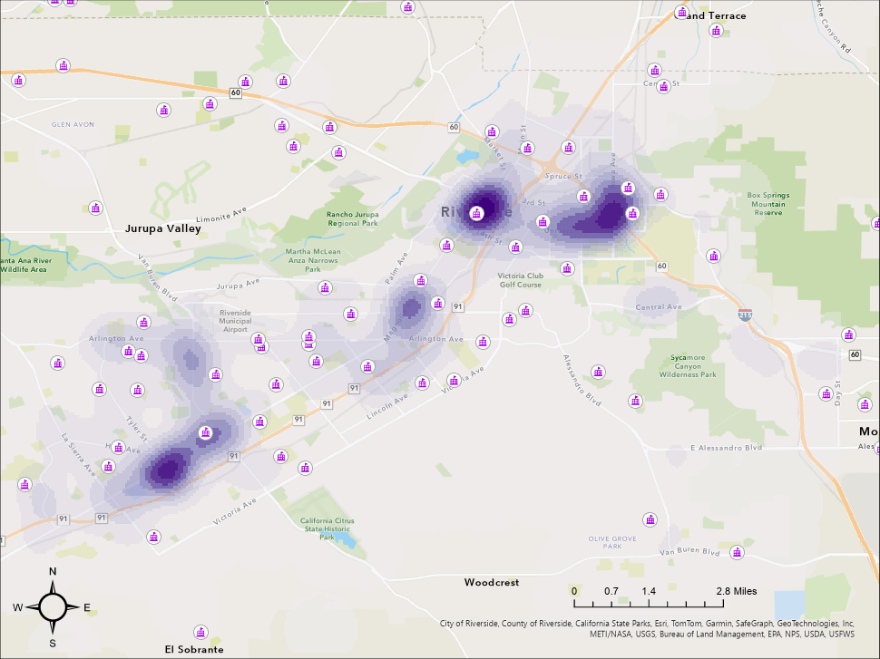
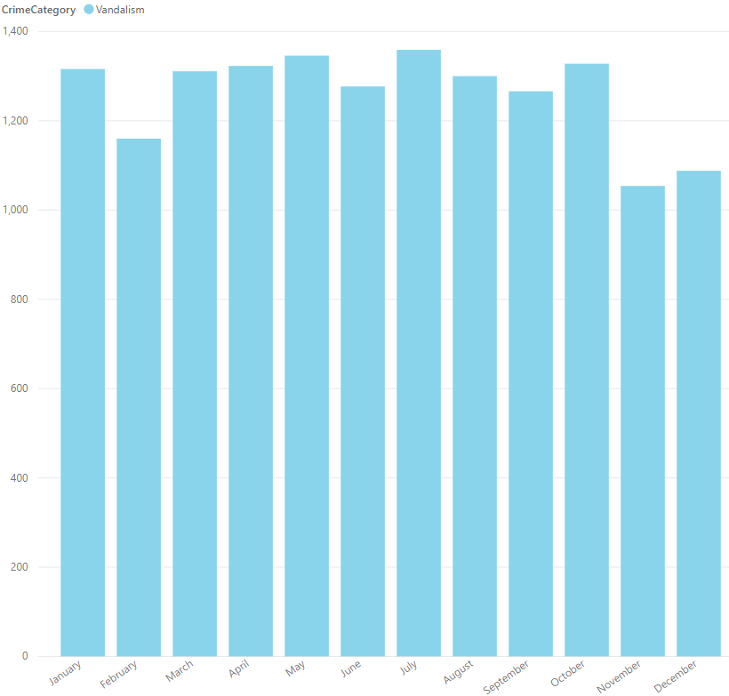
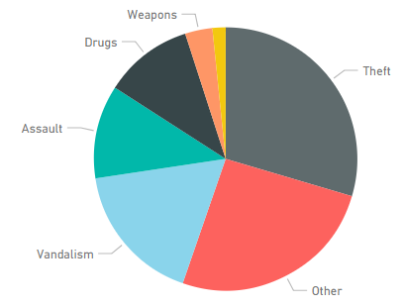
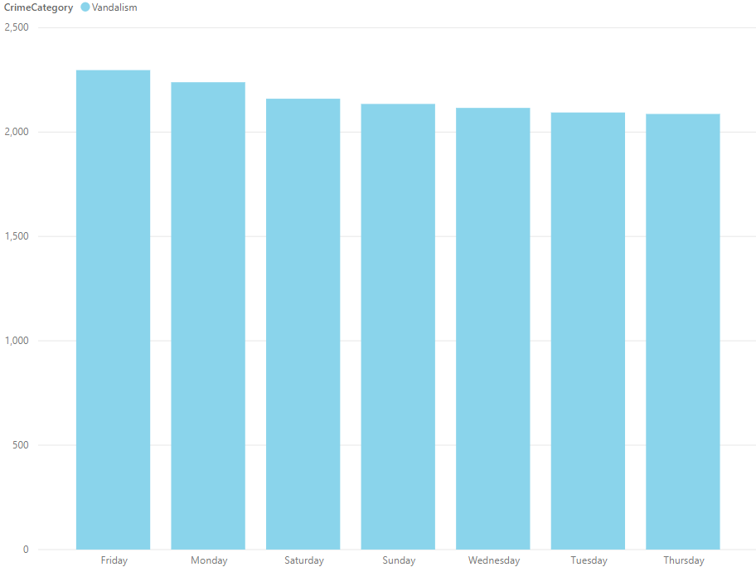
Crime Analysis of Riverside, CA
Carolyn Kennett, Geography BS, Texas Christian University
Introduction
Riverside, California, has historically faced socioeconomic
challenges that shape its urban environment. This study
focuses on the spatial distribution of vandalism crimes near
schools from 2020 to 2023. By examining patterns of
vandalism incidents in relation to school locations, this
research highlights the influence of schools on local crime
dynamics. The findings aim to provide data-driven insights
to support school safety initiatives and inform strategies to
mitigate vandalism in surrounding neighborhoods.
Vandalism Decline
This map shows the percent decrease in vandalism crimes
from 2021 to 2023 across neighborhoods in Riverside, CA,
highlighting the influence of schools on crime reduction.
Riverside Crime Hotspots
This map highlights vandalism hotspots in Riverside from
2020 to 2023, with darker purple areas indicating higher
concentrations of crime, particularly around urban centers
and major transportation corridors.
Study Area: Riverside, CA
Methodology
This study analyzes vandalism crimes near schools in
Riverside, CA, from 2020 to 2023. I sourced the crime data
from local crime reports, which included multiple crime
types. Then, I used Python to filter the dataset, isolating
vandalism incidents for analysis. I found neighborhood
boundary data from the City of Riverside and scraped
school location data from Google Maps. ArcGIS Pro helped
me clean datasets. I created appealing maps about the
percentage decrease in vandalism crimes near schools and
identify hotspot areas. The study also utilized Power BI to
create interactive graphs. It visualized vandalism trends by
month and day of the week and highlighted vandalism’s
proportion relative to other crime categories for deeper
insights.
Conclusion
Vandalism has a significant impact on many schools.
Overall, it accounts for a significant portion of all crimes.
Trends show slightly higher rates during the summer
months and weekends. These are times when kids are not
in school—an interesting pattern that might reflect reduced
supervision or increased opportunities for vandalism.
The maps show a drop in vandalism near schools,
suggesting that schools might play a role in reducing local
crime. The decrease in vandalism near schools creates a
safer and more welcoming environment for students and
staff. It also reduces distractions and allows schools to
focus more on education rather than dealing with damage
or repairs. Lastly, the decreases in vandalism builds a
stronger sense of community in the school areas.
The hotspot map shows the spots with persistent
vandalism. These are near major urban centers and
transportation corridors which have increased foot traffic,
accessibility, and limited community oversight. The
concentration of vandalism in these hotspots implies they
need safety measures, such as improved lighting, increased
surveillance, and stronger community engagement, to
address these challenges and protect both schools and
surrounding neighborhoods.
Proportion of Crime
Categories in Riverside, CA
This pie chart reveals that vandalism constitutes a significant
portion of all reported crimes in Riverside, CA, highlighting
its relevance as a key focus for understanding crime patterns
near schools and developing targeted safety strategies.
Vandalism by Month
This bar chart highlights that vandalism incidents remain
relatively consistent, with slight peaks during the summer
months (July and August) and a dip in February and
December. These trends may indicate seasonal factors
influencing vandalism near schools, such as school holidays
or increased activity during warmer months.
Vandalism by Day of Week
This bar chart reveals weekends and the days surrounding
them have slightly higher instances of vandalism crimes,
suggesting that these time periods may require increased
attention and resources for crime prevention near schools.
Sources
County of Riverside. Open Data Portal. County of Riverside, https://data.countyofriverside.us. Accessed 1 Dec. 2024.
Google Maps. Google, https://maps.google.com. Accessed 1 Dec. 2024.

